Slide 1
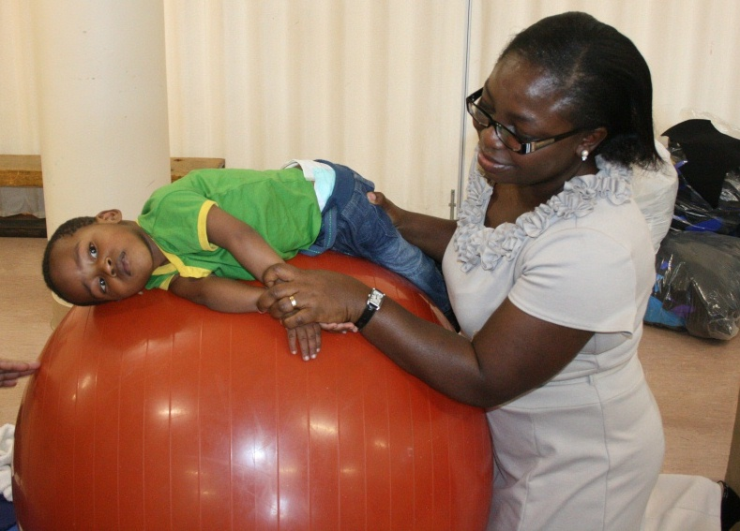
Identify equipment used in a physiotherapy unit
Function of the unit
All equipment used in the unit
18.4.1 Identify equipment used in a physiotherapy unit
Unit C18.4 Maintaining Physiotherapy Equipment
Module 279 19 C Medical Instrumentation II
©
dr. Chris R. Mol, BME, NORTEC, 2015

Slide 2
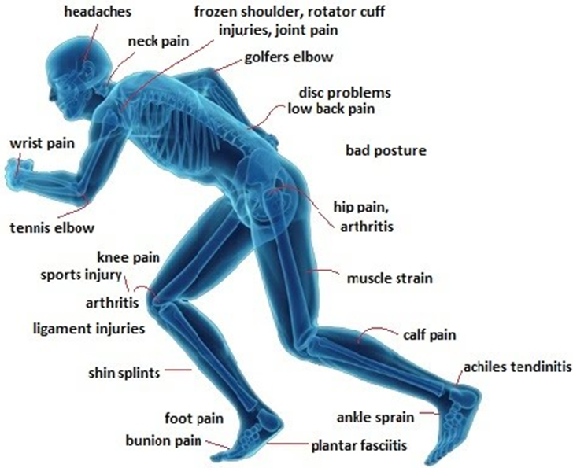
Physiotherapy or Physical therapy
The aim of physiotherapy is to help restore movement and normal body function in cases of illness, injury and disability.
Physio Therapy is mostly part of Rehabilitation (as opposed to Monitoring, Prevention, Screening, Diagnosis or Therapy).
It is about making somebody fit or capable of doing something they can no longer do properly or at all, but used to be able to - i.e. restoring an ability or abilities.
Physiotherapy commonly includes assistance with:
Movement and exercises, including fitness and wellness-oriented programs,
Manual therapy,
Mechanical devices such as traction,
Physical agents which includes heat, cold, electricity, sound waves and radiation
Sometimes, therapies such as acupuncture are also considered to be part of physiotherapy.
©
equipment used in a physiotherapy unit
dr. Chris R. Mol, BME, NORTEC, 2015

Slide 3
Physiotherapy is applied to many health problems
Physiotherapy is part of rehabilitation in many conditions and disease, including:
recovery from cardiovascular surgery
geriatrics (old people), including arthritis, osteoporosis, …
wounds and burns
neurological diseases, such as chronic back pain, stroke, ….
muskelo-skeletal system: back and neck pain, rehabilitation after orthopaedic surgery
pediatric application: congenital and developmental diseases.
sports, including injury management
women’s health, including child-birth, post-partum problems
palliative care for very seriously ill people
©
equipment used in a physiotherapy unit
dr. Chris R. Mol, BME, NORTEC, 2015

Slide 4
1. Movement and Exercise
Physiotherapists use therapeutic exercises designed to improve mobility and strengthen the affected area of the body. They need to be repeated regularly, usually daily, for a set number of weeks.
As well as specific exercises, gentle activities, such as walking or swimming or aquatic therapy may be recommended if you're recovering from an operation or sports injury that affects your mobility.
Aquatic therapy (hydrotherapy)
Aquatic therapy is carried out in water – usually a warm, shallow swimming pool or special hydrotherapy pool. It's often used with children and adults who have physical and learning disabilities. Aquatic therapy can help improve blood circulation, relieve pain and relax muscles. It can also help with mobility because activities that aren't possible to do on dry land can be performed in the water.
For someone with a mobility problem caused by a condition such as a stroke, a physiotherapist may suggest specific exercises which target the affected area of the body.
There's evidence to show that physical activity can help manage and prevent many health conditions. For example, physically active adults have been shown to have a significantly lower risk (up to 50%) of developing major health conditions such as coronary heart disease, stroke, diabetes and cancer.
©
equipment used in a physiotherapy unit
dr. Chris R. Mol, BME, NORTEC, 2015

Slide 5
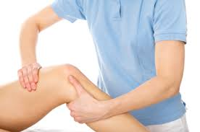
2. Manual therapy
Manual therapy uses 'hands on' treatment techniques to mobilise joints and soft tissues. It most commonly includes kneading and manipulation of muscles, joint mobilization and joint manipulation.
It's suitable for most people and can be used to:
relieve pain
improve blood circulation
help fluid drain more efficiently from parts of the body
improve the movement of different parts of the body
Massage is a special case of manual therapy. It is typically the repetitive rubbing or kneading of muscle tissues to improve interstitial fluid dynamics. Massage is used to reduce tension, anxiety, stress, and promote overall circulation, relaxation, and flexibility.
©
equipment used in a physiotherapy unit
dr. Chris R. Mol, BME, NORTEC, 2015

Slide 6
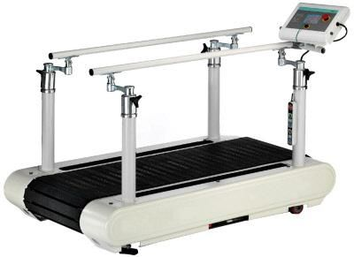
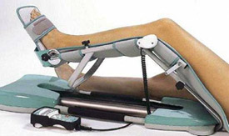
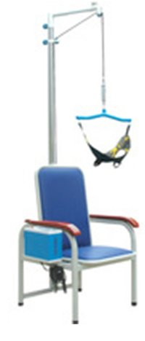
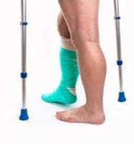
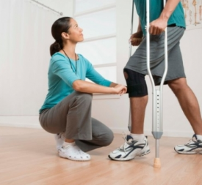
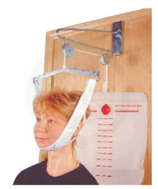
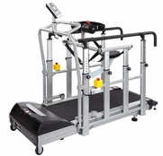
3. Mechanical Devices (selection)
©
equipment used in a physiotherapy unit
dr. Chris R. Mol, BME, NORTEC, 2015

Slide 7
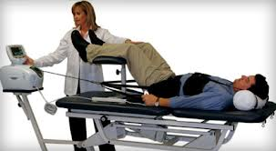
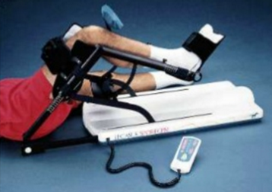
3. Mechanical Devices (selection)
http://www.slideshare.net/NationalBurnsCentre2000/ppt-dept-design-by-dr-sunil-keswani-national-burns-centre-airoli
A Traction machine applies mechanical forces on the spine to reduce compression in the spinal column and address back pain and other symptoms from compressed nerves.
Continuous passive motion helps to reduce pain and oedema and maintain range of motion. It can be applied for hours per day, without need for continuous presence of the physiotherapist.
Note: wheel chairs, crutches, etc. are part of Rehabilitation Aids, not PhysioTherapy.
©
equipment used in a physiotherapy unit
dr. Chris R. Mol, BME, NORTEC, 2015

Slide 8
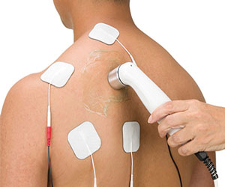
4. Physical Agents
}
Ultrasound
Infrared treatment
See further on
Electro Stimulation
Diathermia
This is where the medical equipment is used in physiotherapy
©
equipment used in a physiotherapy unit
dr. Chris R. Mol, BME, NORTEC, 2015

Slide 9
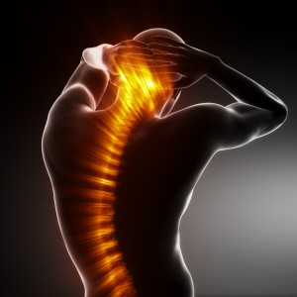
Heat Therapy
Heat therapy, also called thermotherapy, is the use of heat in therapy.
It can take the form of a hot cloth, hot water, ultrasound, infrared light, and others. It can be beneficial to those with arthritis and stiff muscles and injuries to the deep tissue of the skin.
Heat therapy is most commonly used for rehabilitation purposes.
The therapeutic effects of heat include increasing the extensibility of collagen tissues; decreasing joint stiffness; reducing pain; relieving muscle spasms; reducing inflammation, oedema, and aids in the post acute phase of healing; and increasing blood flow.
The increased blood flow to the affected area provides proteins, nutrients, and oxygen for better healing.
Different methods for heat therapy use different ‘physical agents’ but appear to all have the same clinical purpose.
Some devices enable multiple treatment methods, with multiple transducers / probes
©
equipment used in a physiotherapy unit
dr. Chris R. Mol, BME, NORTEC, 2015

Slide 10
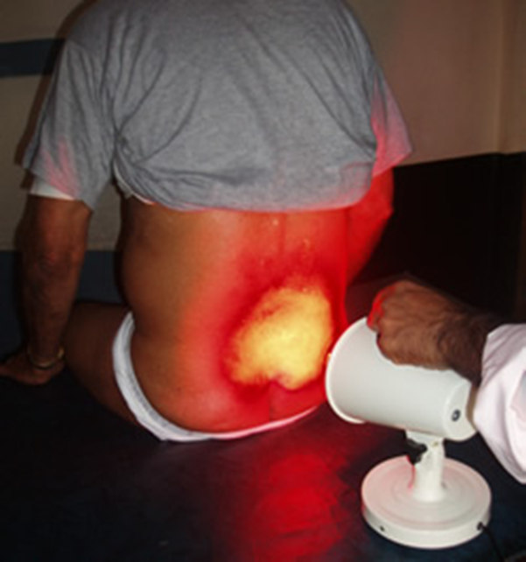
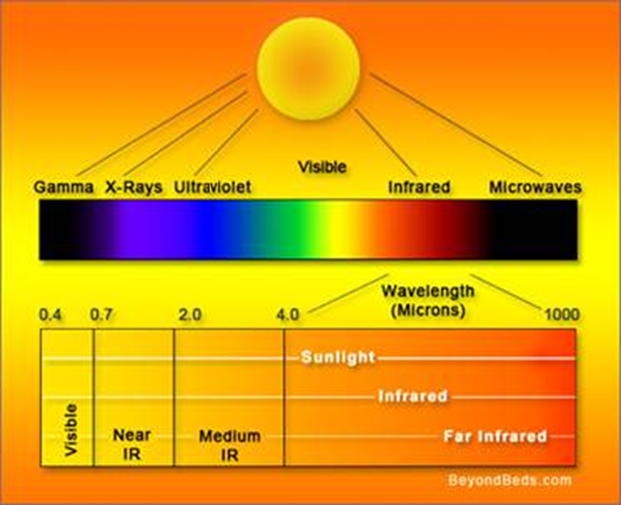
Infrared treatment light
In infrared light therapy, (red light energy and) invisible near-infrared energy is absorbed in the cells. The body experiences this energy as a gentle radiant heat.
©
equipment used in a physiotherapy unit
dr. Chris R. Mol, BME, NORTEC, 2015

Slide 11
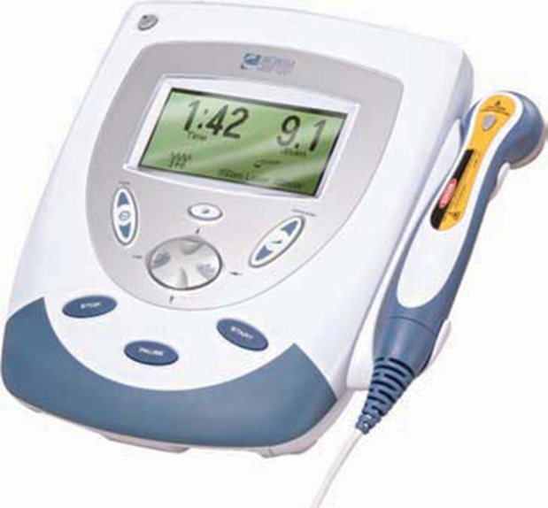
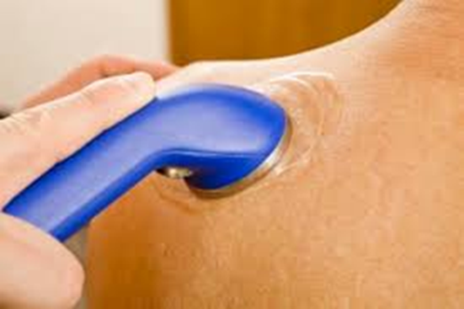
Therapeutic Ultrasound
High dose, therapeutic ultrasound can be used to stimulate the tissue beneath the skin's surface using frequencies between 0.8 and 2.0 MHz. (Diagnostic ultrasound uses 2.0 – 5.0 MHz)
Results are achieved because of the absorption of the ultrasound energy in the tissue.
Maximum energy absorption in soft tissue occurs from 2 to 5 cm.
©
equipment used in a physiotherapy unit
dr. Chris R. Mol, BME, NORTEC, 2015

Slide 12
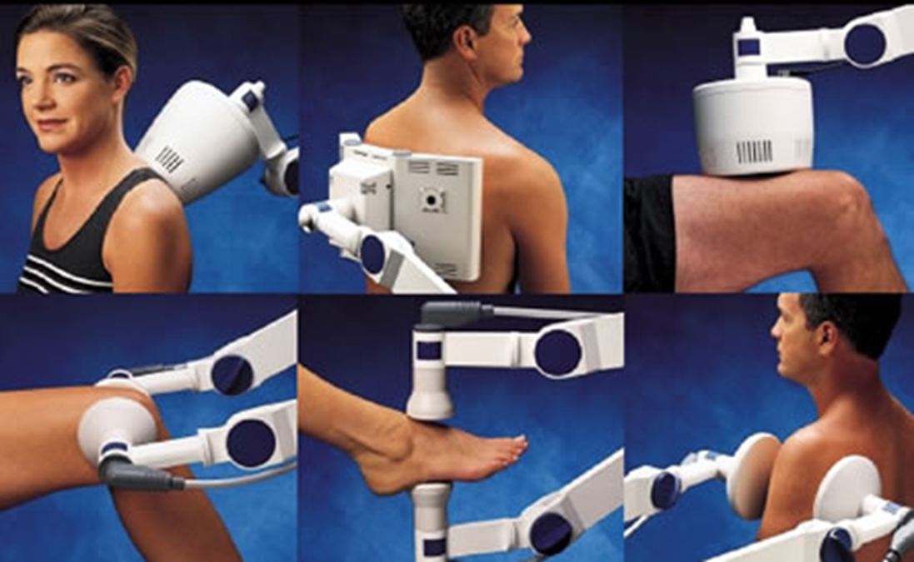
Short Wave Diathermy (SWD) machine
In Short Wave Diathermy, radio frequency electro-magnetic energy of high intensity is directed at biological tissues.
This causes heating. It is generally used to provide relief from pain and inflammation in the joints and muscles.
©
equipment used in a physiotherapy unit
dr. Chris R. Mol, BME, NORTEC, 2015

Slide 13
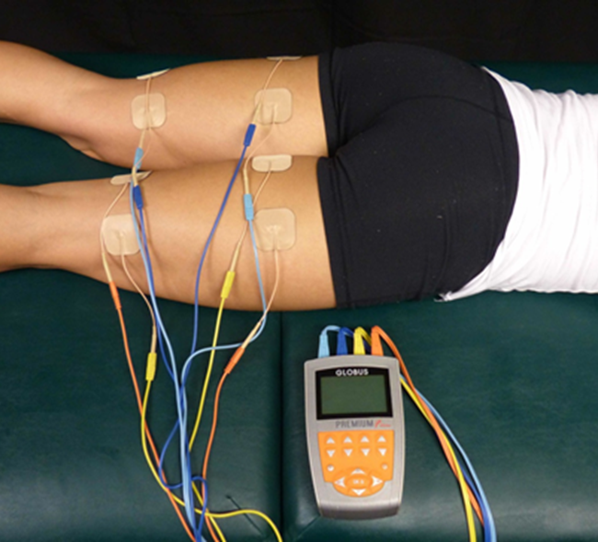
Electro muscular Stimulator
Electrical muscle stimulation (EMS) generates muscle contraction using electric impulses. The device generates electrical impulses which are delivered through electrodes on the skin close to the muscles to be stimulated. The impulses mimic the nerve signals which normally come from the central nervous system, causing the muscles to contract.
Applications:
a strength training tool for healthy subjects and athletes,
a rehabilitation tool for immobilized patients with muscle injuries,
a testing tool for evaluating the neural and/or muscular function
©
equipment used in a physiotherapy unit
dr. Chris R. Mol, BME, NORTEC, 2015

Slide 14
END
The creation of this presentation was supported by a grant from THET:
see https://www.thet.org/

